Slide 1

Team 20
Contacts Manager

Slide 2
Team Introduction
Phat Huynh – Project manager and Front-end
Rafael Niebles – Front-end
Thomas Trivino - API
Ahmet Cetin - Database

Slide 3
Technology Used
Discord – used for communication and feedback within the group
Figma – used for UI design before code implementation of the front-end
Online Gantt - used for organizing the due dates for each of the responsibility
GitHub – used for collaboration and documentation of the work done by each member. The documentation can be used to revert to previous saves if something breaks
Visual paradigm- used to create the use case diagram and the entity relation diagram

Slide 4

Things that went well
Database ready in week 1 - Minimal issues after locking a simple ERD and seed data.
Clear team cadence - Weekly check-ins with teammates kept tasks on track and deadlines visible.
API stood up early - Auth + contacts (search/create/edit/delete) implemented and documented, unblocking the UI.
Consistent UI design - Reusable components + a simple theme meant only minor tweaks.
Fast UI implementation - Core screens shipped within a week of design sign-off.

Slide 5
Things that did not go well
Integrating
Integrating backend with API calls and responses
Creating
Creating an effective search without loading all contacts in DM to memory
Documenting
Documenting the API with SwaggerHub was a long and unfamiliar process
Ensuring
Ensuring proper testing of the website

Slide 6
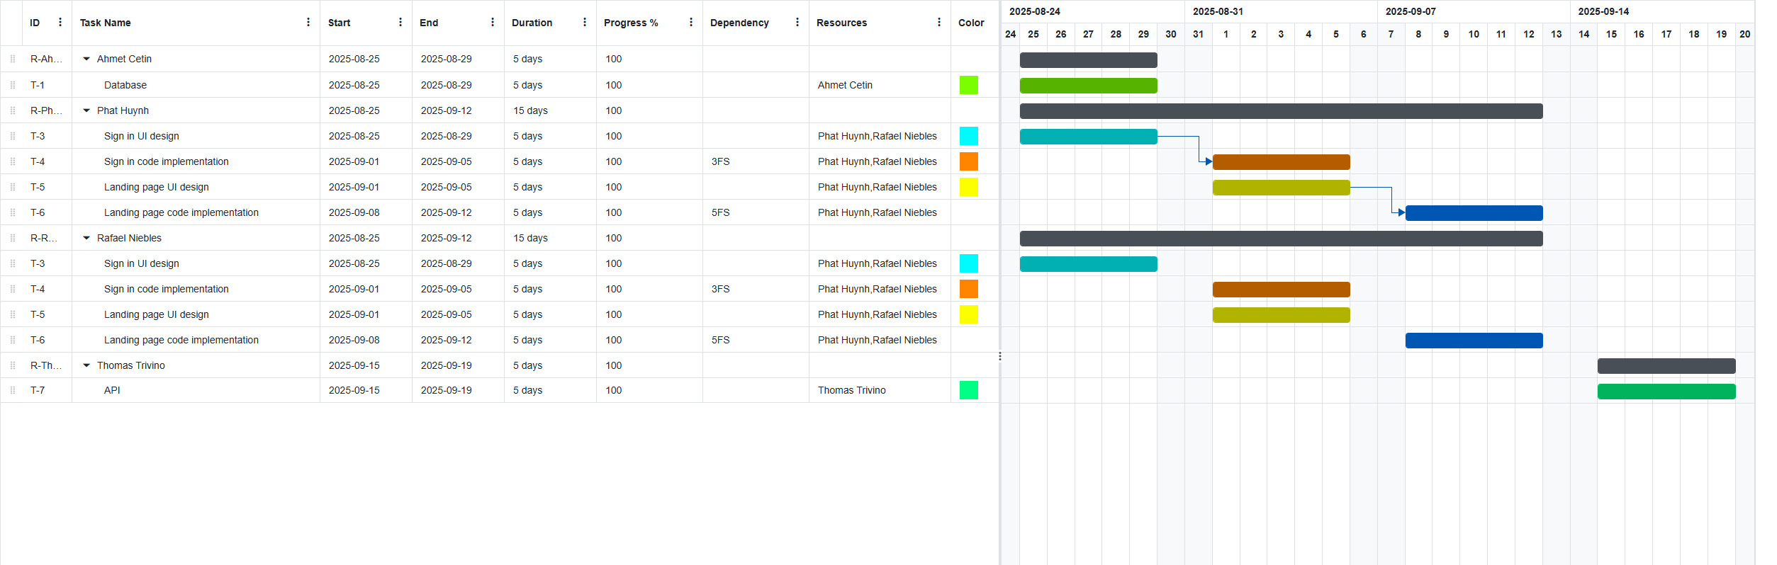
Gannt Chart

Slide 7
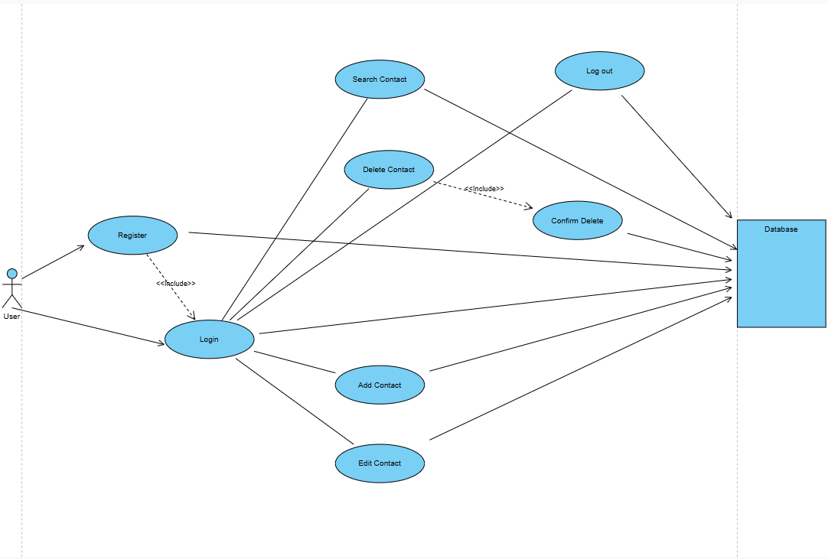
Use Case diagram
Contact Manager
Goal: Visual map of what a user can do in the Contact Manager—independent of UI and database.
System boundary: All ovals sit inside “Contact Manager.”
Authentication gate: Register and Login are prerequisites to protected features.
Core capability: Manage Contacts bundles day-to-day actions (Search, Add, Edit, Delete).
Session control: Log out ends the authenticated session (revokes access to contact management features).

Slide 8
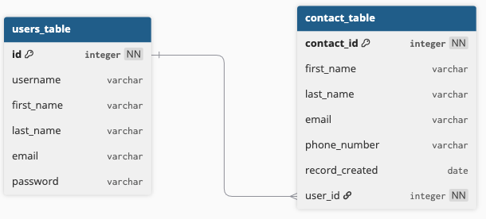
Entity relation diagram
Schema: users_table (auth/profile) and contact_table (address-book entries).
Relationship: 1→N — each contact belongs to exactly one user.
App behavior: CRUD always filtered by user_id; FK prevents orphan contacts.
passwords stored as hashes in DB

Slide 9

https://app.swaggerhub.com/apis/universityofcentralf-9ab/Contact-Manager/1

Slide 10

Sign In - Contact Manager

Slide 11
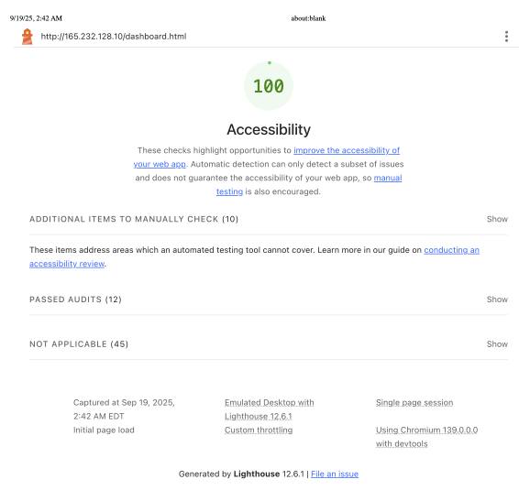
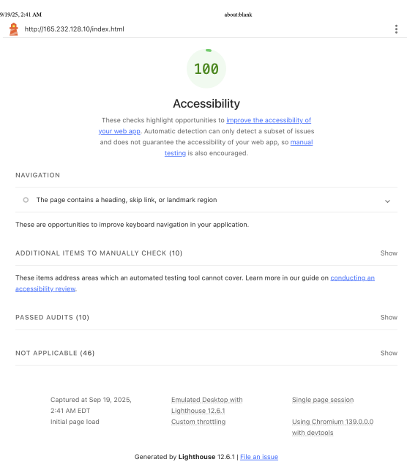

Lighthouse Accessibility Reports

Slide 12

Questions time

